Slide 1
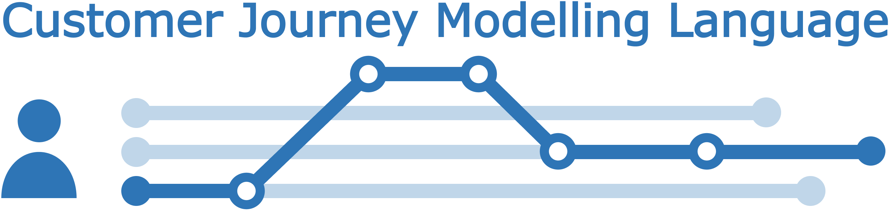
Introduction
CJML - Customer Journey Modelling Language
Version 2.0
SINTEF Digital
November 2022

Slide 2


Overview of CJML 2.0 resources
Introduction
Overview, purpose and target group
Modelling approach
Visual notation
Diagrams types and symbols
Features and examples
Diagram generator
Templates for easy diagramming
Examples
The CJML material consists of several modules that are to be seen in connection to each other. All the CJML resources can be found here: www.cjml.no
Main change in this version:
An expanded terminology and a data exchange format
Change in the visual notation of the journey network diagram (message flow between sender and receiver)
Terminology
Definitions, attributes, and class diagrams
Meta-model
Data format
XML schema
XML examples
XML description

Slide 3
Contents
Readers guide
  Who can use this material?
  Additional resources
Introducing CJML
  Key facts
  Target group
  Development and origin
Theoretical foundation and modelling approach
  Planned and actual journeys
  Journey types and examples
  Touchpoint typology
  Delineation of steps
A quick tour of CJML
  Diagram types and examples
  Comparison of diagram types
  Customer/User experience
From scenario to journey
  Example - alarm service
  From business scenario to planned journey
  From user scenario to actual journey

Slide 4


Who can use this material?
CJML v2.0 by SINTEF Digital is licensed under a Creative Commons Attribution-ShareAlike 4.0 International License.
Anyone can use, copy, and transform the material in any medium or format – for any purpose – under the following terms:
  Attribution: You must give appropriate credit, provide a link to the license, and indicate if changes were made
  ShareAlike: If you remix, transform, or build upon the material, you must distribute your contributions under the same license as the original.
Guidance on how to give appropriate credit can be found here:
https://creativecommons.org/use-remix/
https://wiki.creativecommons.org/wiki/Best_practices_for_attribution
The current version of CJML was released through the research project Smart Journey Mining funded by the Research Council of Norway (grant no. 312198).

Slide 5
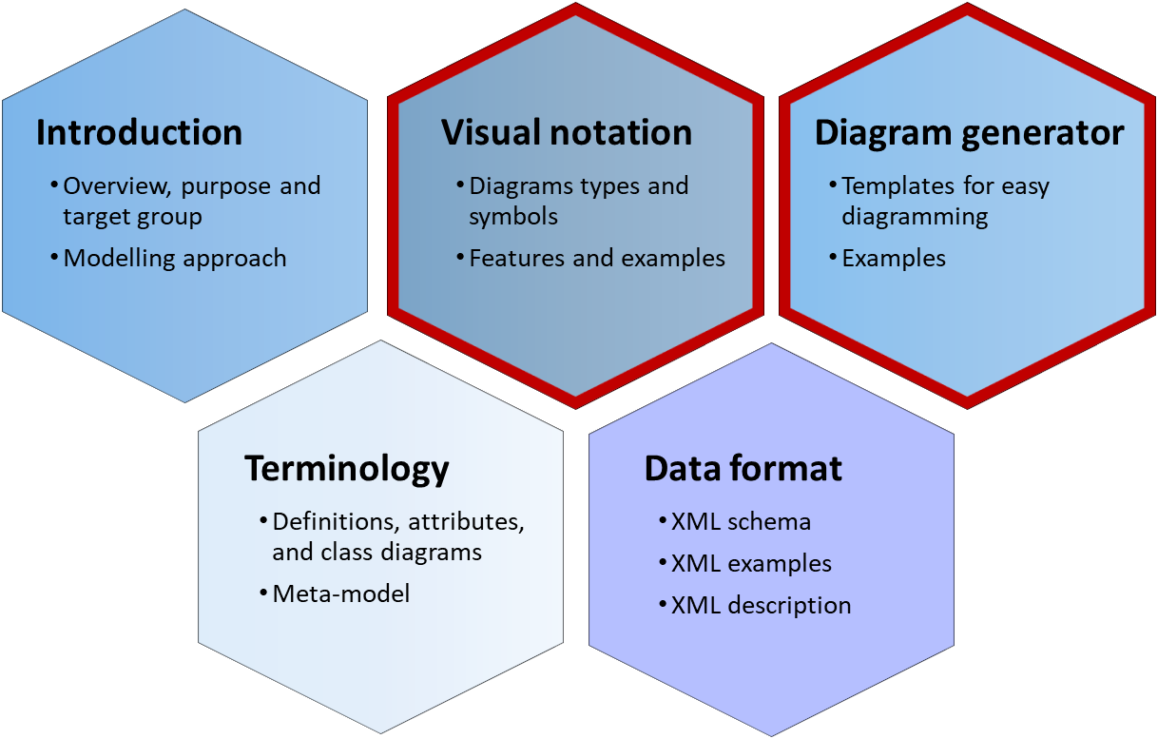
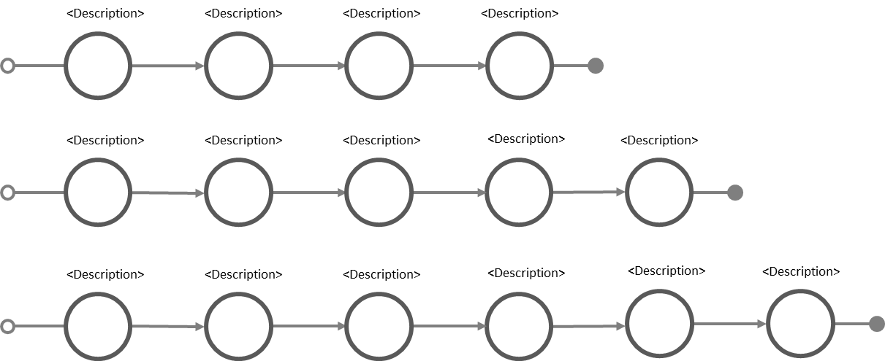
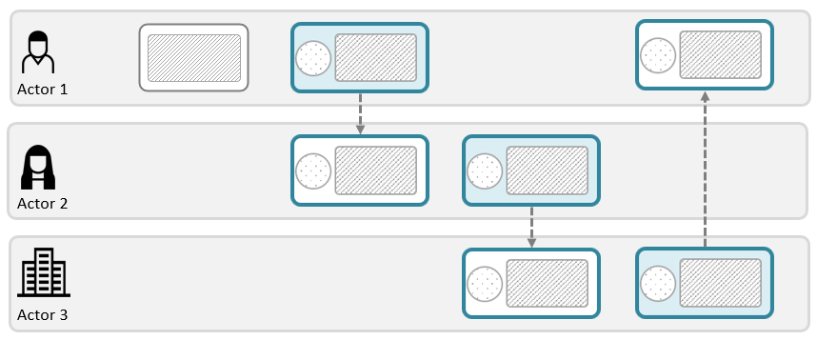
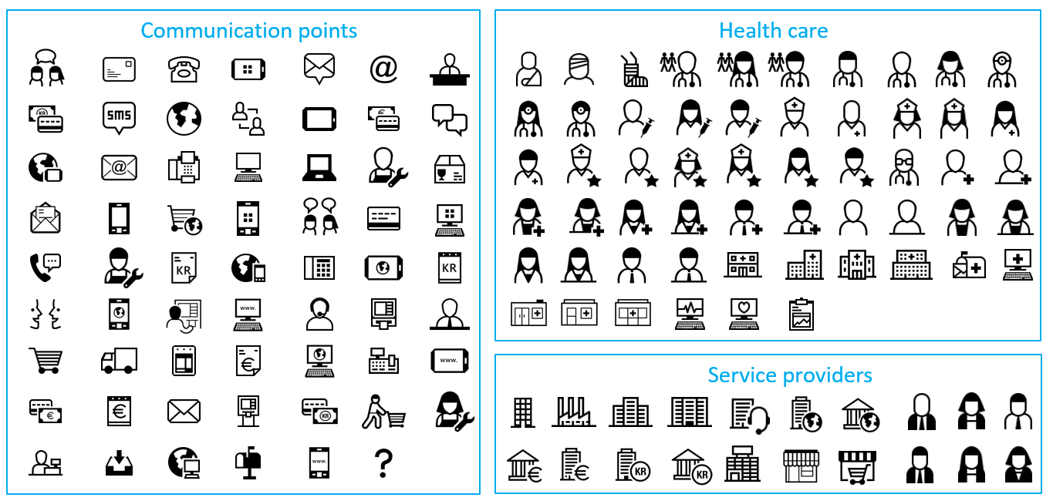
Additional CJML resources
These modules contain support for making diagrams
Please visit the CJML web page www.cjml.no
Alternatives for creating diagrams:
  Simply copy-paste elements from the Visual notation slides and modify for your own use
  Use the templates in the Diagram generator slides
  Download the graphical elements in bitmap or vector format
  See the web page for other visual tools
Template – simple journey diagram
Template – journey network diagram
Symbol gallery

Slide 6
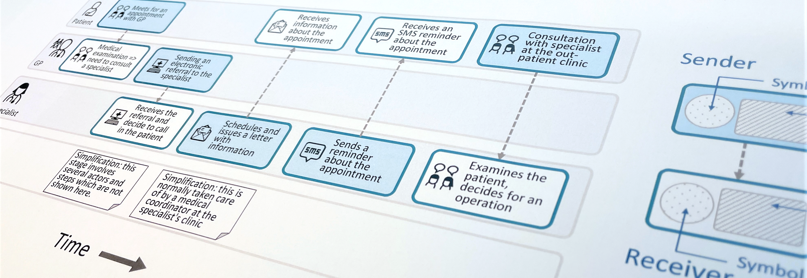
CJML - Customer Journey Modelling Language
CJML is a visual language dedicated to modelling of human journeys, regardless of whether the human has the role of customer, user, patient, or citizen.
Customer journey
User journey
Employee journey
Patient journey
Citizen journey

Slide 7
Introducing CJML
Key facts
Target group
Development and origin

Slide 8
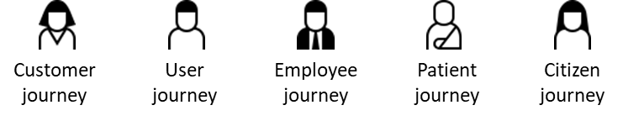
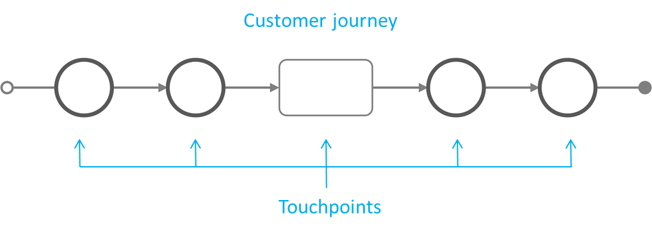
Key facts I
CJML is a formal language for specification and visualization of customer journeys modelled as sequences of touchpoints
CJML is centred around humans and human activities, regardless of whether the human has the role of customer, user, patient, or other.
CJML consists of terminology, diagrams, a data format, methods and tools.
The basic concepts of the language are customer journeys and touchpoints.
Customer journeys are modelled as sequences of touchpoints to achieve a specific goal or outcome.
CJML distinguished between touchpoints that communicate a message (circle) and those which does not (square).
Introducing CJML
Theoretical foundation and modelling approach
A quick tour of CJML
From scenario to journey

Slide 9
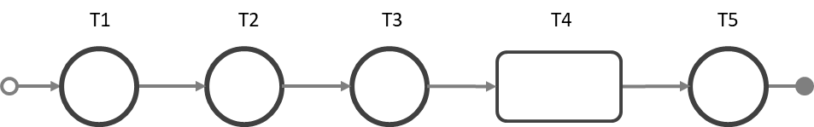
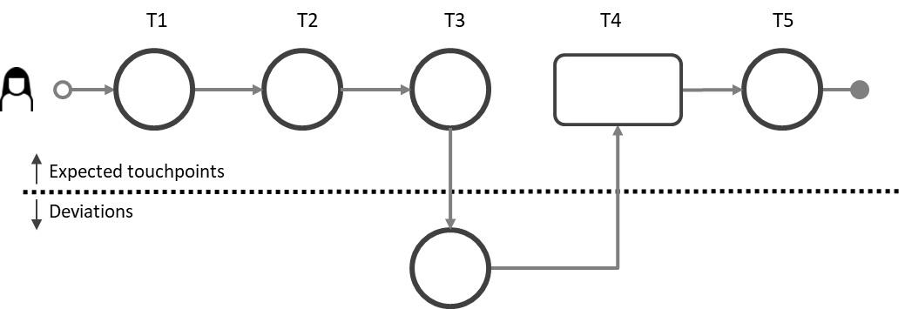
Key facts II
CJML differs from other process languages in two principal ways:
  CJML models the service process from the end-user's point of view
  CJML aims at being intuitive for a wide user group
CJML describes service processes in two states:
  The hypothetical state (planned journey)
  The real state – with an individual user (actual journey).
Planned journey
Actual journey
Introducing CJML
Theoretical foundation and modelling approach
A quick tour of CJML
From scenario to journey

Slide 10
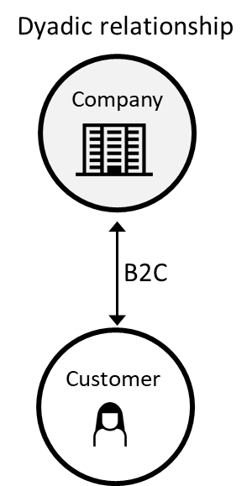
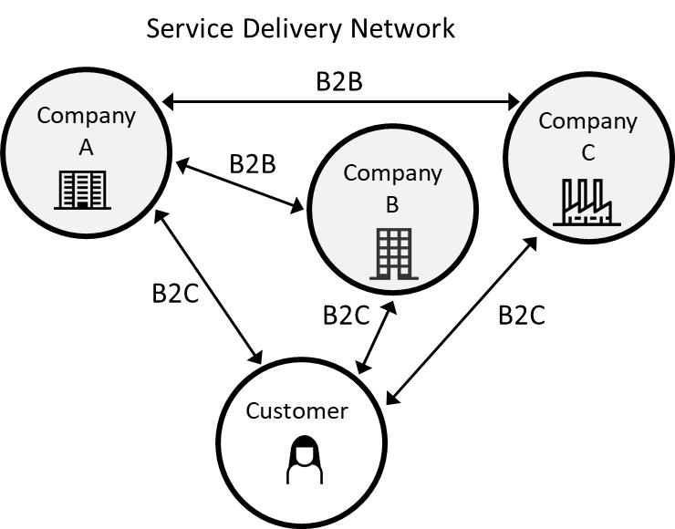
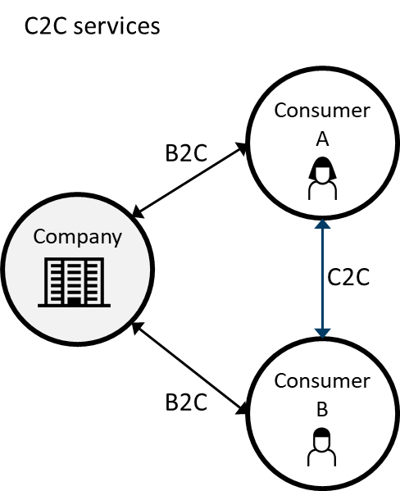
Key facts III
CJML addresses the detailed interactions between
  a human and one or more service providers.
  or a network of users and service providers (C2C, B2C, B2B2C etc).
CJML is well suited for service processes that extends over time and mediated by different communication channels.
CJML is particularly targeting service processes that are technology-driven and repeated in high volumes.
Introducing CJML
Theoretical foundation and modelling approach
A quick tour of CJML
From scenario to journey

Slide 11
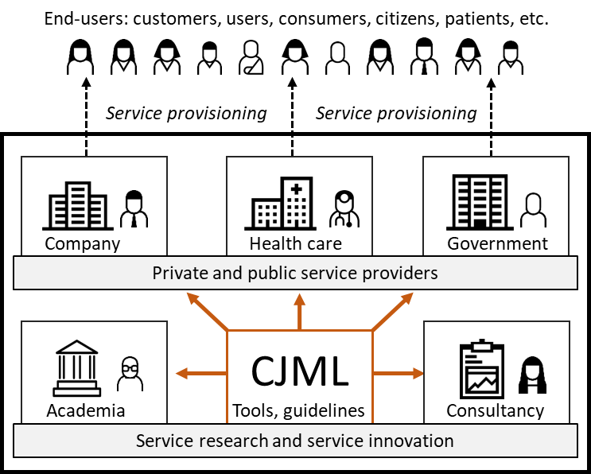
Target group of CJML
The end-users embarking on a journey
Target group
CJML is relevant to anyone who works with service research or service provisioning, whether you are engaged in service design, business development or customer support.
The core elements of CJML targets a wide user group, in principle "everyone" in a service providing organization.
CJML does not require a technical background.
The more advanced features of CJML targets analysts, system developers, and researchers.
Systematic evaluations have shown that new users can easily adopt CJML and make customer journey diagrams with a high level of precision.
Halvorsrud, R., Sanchez, O., Boletsis, C., & Skjuve, M. (2023). Involving users in the development of a modeling language for customer journeys. To appear in SoSyM (International Journal on Software and Systems)
Halvorsrud, R., Haugstveit, I. M., & Pultier, A. (2016). Evaluation of a modelling language for customer journeys. Proceedings from the IEEE Symposium on Visual Languages and Human-Centric Computing, pp. 40-48. IEEE Xplore. doi:10.1109/VLHCC.2016.7739662
Introducing CJML
Theoretical foundation and modelling approach
A quick tour of CJML
From scenario to journey

Slide 12
Development and origin
The current version was released through the research project Smart Journey Mining funded by the Research Council of Norway (grant no. 312198).
Guideline 1: Design as an Artifact.
Guideline 2: Problem Relevance.
Problem relevance and user require-ments have been derived through operational work with case partners, interviews with stakeholders, literature studies, and surveys.
Guideline 3: Design Evaluation.
CJML has been evaluated continuously through both informal evaluation (case studies, workshops, external input) and formal evaluation using controlled experiments.
Guideline 4: Research Contributions.
Guideline 5: Research Rigor.
Guideline 6: Design as a Search Process.
Guideline 7: Communication of Research.
CJML constitutes a new approach to customer journey methodology, allowing for detailed and precise modeling of actual journeys and the comparison of these against planned journeys.
A mixed method approach has been used to develop and evaluate CJML, e.g., interview, case study, survey, and controlled experiment. CJML is defined through a set of specification documents and design templates.
An UCD approach has been applied throughout with frequent iterations with the target group. We have also received continuous feedback from external users.
CJML has been publicly available online throughout the development process. CJML has been presented in academic and practice-oriented conferences, reaching both technology- and management-oriented audiences.
CJML is an artifact developed for precise modeling of customer journeys to support journey discovery, journey conformance, and journey redesign.
CJML has been developed in close collaboration with industry partners through multiple research and innovation projects from 2012 until today.
The development of CJML adheres to the seven guiding principles
of design-science research.
Hevner, A.R., March, S.T., Park, J., Ram, S.: Design science in information systems research. MIS Quarterly 28(1), 75–105 (2004)
The early versions of CJML was called VISUAL, named after the VISUAL project (2013-2016). More information about this project can be found here: www.visualproject.org
Introducing CJML
Theoretical foundation and modelling approach
A quick tour of CJML
From scenario to journey

Slide 13
Theoretical foundation and modelling approach
Planned and actual journeys
Journey types and examples
Touchpoint typology
Delineation of steps

Slide 14
Two states of a service process
The planned journey..
The actual journey..
reflects how the service process is implemented by the service provider(s) - regardless of whether it was deliberately designed or resulted from ad-hoc development.
may branch into alternative paths as a result of decisions made by the user (e.g. preferred channel) or the service provider.
always involves an individual end-user.
may comply with the planned journey, but often deviates from the planned journey.
is associated with user experience, which is subjective, context dependent, and may change over time.
Planned journey = “theory”
Actual journey = reality
Introducing CJML
Theoretical foundation and modelling approach
A quick tour of CJML
From scenario to journey

Slide 15
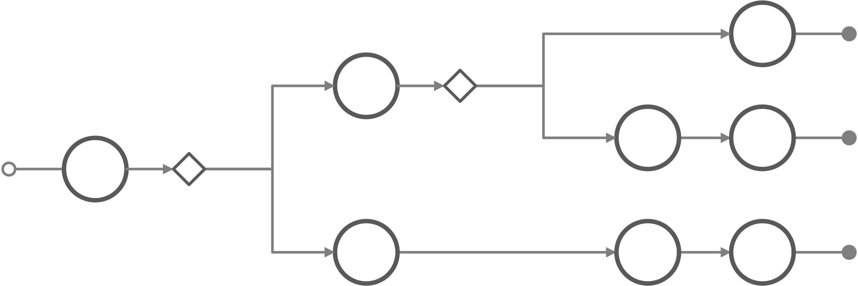
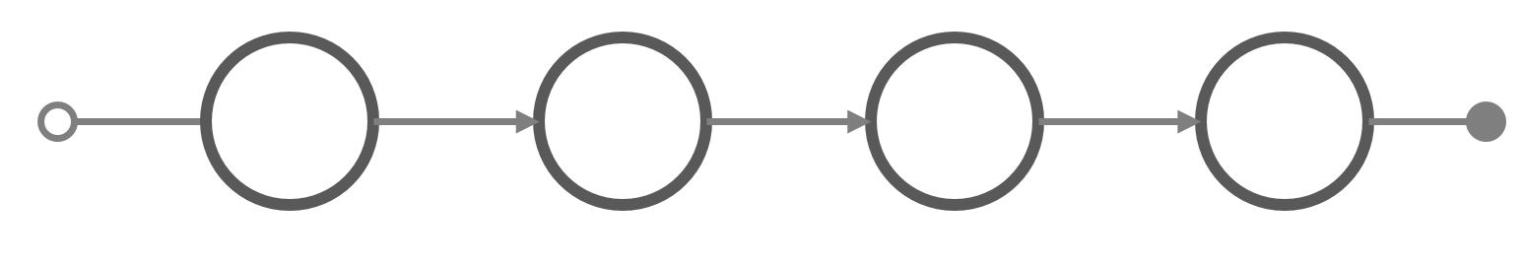
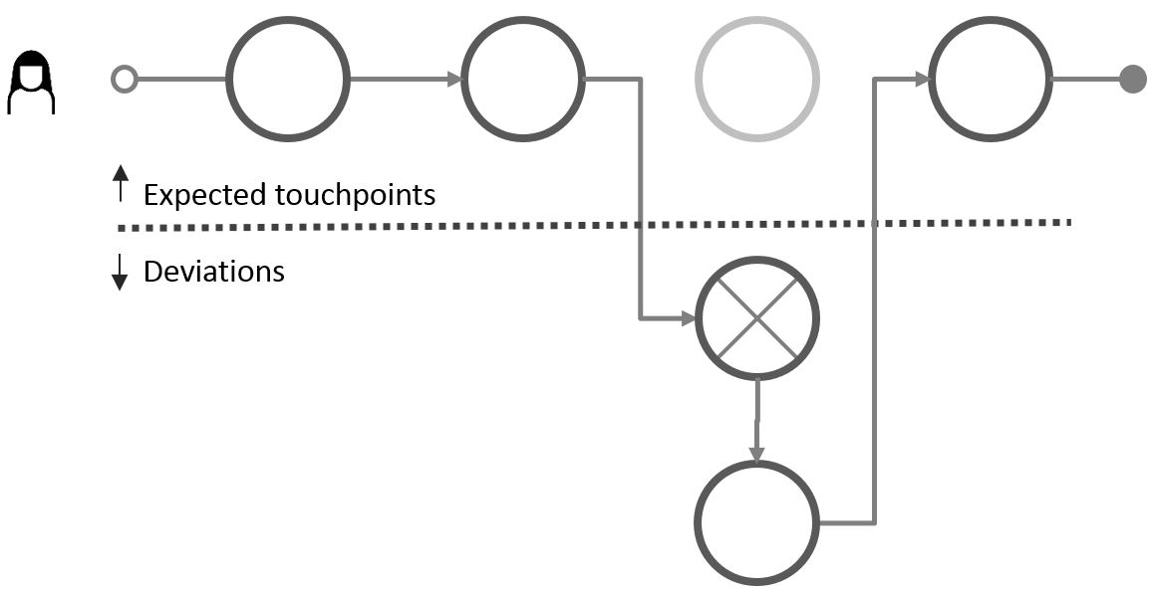
Group versus single journey
The planned and actual service processes are modelled as planned and actual customer journeys, respectively. The generic journeys are the collection of alternative paths of the service process.
  Group of planned journeys
  A set of related journeys that represents alternative ways to achieve a common user goal (e.g. parallel channels). Also, alternatives may result from configurations and dependencies in the business case.
  Planned journey
  One specific journey, as implemented (or planned for the future) by the service provider, given the service conditions
  Actual journey
  The customer journey as experienced by an individual customer during execution of the service process. The example shows several deviations.
An actor’s symbol at the beginning of a journey indicates an actual journey.
Introducing CJML
Theoretical foundation and modelling approach
A quick tour of CJML
From scenario to journey

Slide 16
Two types of touchpoints and diagrams
A journey is modelled as a sequence of touchpoints involved for a human user to achieve a specific goal.
The scope of a journey should be defined in relation to the purpose of the study.
Communication points are instances of communication or interaction between a user and a service provider
Actions are non-communicative events or activities conducted by an actor as part of a customer journey
There are two different types of touchpoints.
This diagram is called the plain journey diagram. There is also a second type available for journeys involving many actors.
Introducing CJML
Theoretical foundation and modelling approach
A quick tour of CJML
From scenario to journey

Slide 17
Example: Group of planned journeys
A utility company offers five different ways to become a new customer.
The many choices of communication channels and messages result in as many as N = 648 unique, alternative journeys
Each circle represents a communication point where the company and customer communicate through e.g. e-mail, SMS, or an app.
1
2
3
4
All the digital touchpoints leave traces and involves internal systems and work processes.
5
Number of journeys =
9 x 18 x 4 = 648

Slide 18

Example: Peter’s actual journey
Peter is a new customer who chooses to sign up through the web page. His journey is outlined in orange colour.
1
Peter has a subjective experience throughout his actual journey
2
This was definitely not that easy…
I prefer to order through the web site.
3
4
The customer has completed one out of the 648 possible paths.
The journey consisted of
13 touchpoints.
5
Number of journeys =
9 x 18 x 4 = 648

Slide 19

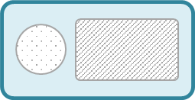
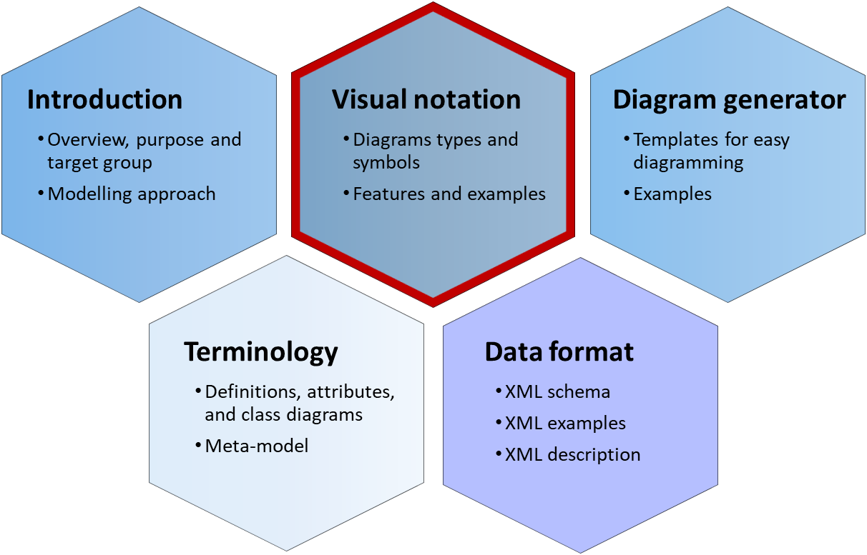

Modelling of communication points
Message
In CJML, communication is defined through a simplified Shannon- Weaver model of linear communication, where a sender transmits a message to a receiver through a communication channel. This model is pertinent for technology-mediated communication, but clearly has its limitation, e.g. in the case of human conversation.
Communication channel
Actor 1
(initiator)
Actor 2
(receiver)
Shannon, C. E., & Weaver, W. (1963). Mathematical theory of communication. Urbana, IL: University Illinois Press.
Visual representation of a communication point
The visual appearance of touchpoints depends on the diagram type.
Plain journey diagram
Journey network (swimlane) diagram
Communication channel
Communication channel
All the details of the two diagram types can be found in the Visual notation module.
text area
Actor 1
(initiator)
Actor 1
(initiator)
message flow
Actor2
(receiver)
text area
Useful for simple journeys and for showing deviations from the planned journey.
Useful for journeys with several actors, and for showing both initiator and receiver.
Introducing CJML
Theoretical foundation and modelling approach
A quick tour of CJML
From scenario to journey

Slide 20
More about customer journeys
Customer journey
A customer journey is defined as a sequence or constellation of touchpoints involved for a customer to achieve a specific goal or a desired outcome. The start and end of the journey must be seen in context with the purpose of the analysis.
As a common method in service design, customer journey mapping is practiced in various ways. However, there are some common factors that can be seen across most approaches:
The journey is based on the customer's point of view
The journey has a time dimension – or a process nature
The journey is divided into steps
Note that a journey might involve both voluntary and/or mandatory aspects, and the outcome might (or not) be desirable for the customer. Example: tax reporting is a mandatory journey, and when resulting in an additional tax payment it has an undesirable outcome.
About customer journeys
The term customer journey is generally used as a metaphor for taking the perspective of the customer (or other end-user).
Customer journey mapping is a method in service design. A journey map is a visual representation of the journey, and it often contains emotions.
Although the method is commonly used in the service industry, it lacks a theoretical foundation and a formalization.
A customer journey is often divided into "before", "during" and "after" the service. Sometimes, these borders are hard to distinguish.
Examples of journeys
Hospitality service: Going to the cinema to watch a movie. The service process comprises ordering and payment of the ticket, retrieval of the ticket, procedures at the movie theatre, and the movie itself.
Health service: Having a knee surgery. The journey starts with a visit to the general practitioner, and continues with a MR scanning, consultation with a specialist, and finally the surgery. The patient has a relation to many different actors throughout the patient journey.
Introducing CJML
Theoretical foundation and modelling approach
A quick tour of CJML
From scenario to journey

Slide 21





Who are involved in a customer journey?
Directly involved actors
The actors on the left side are directly involved in delivering the service to the customer. They have a predefined role in various parts of the planned journey.
External actors
The actors on the right side may influence the customer's journey, although they are not responsible for any part of the service delivery.
Example: In the case of a visit to the cinema, the directly involved actors may be the cinema company and a supply chain partner responsible for the online booking.
Service provider
Friend
Example: In the case of a visit to the cinema, an external actor could be the newspaper that made the customer aware of the film, or a friend who recommended the film.
Customer
Sub-contractor(s)
Newspaper
Note that a customer often see the service providers as one entity, and does not distinguish (or care) about their interrelation.
Introducing CJML
Theoretical foundation and modelling approach
A quick tour of CJML
From scenario to journey

Slide 22
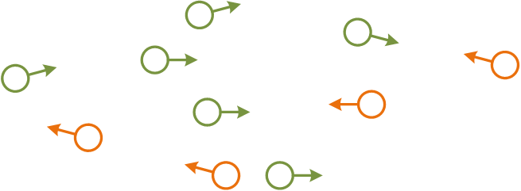


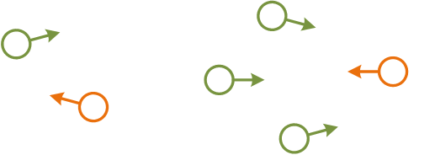
Touchpoints are the "atoms" of a journey
Touchpoint
A customer journey is modelled as sequences of steps that we refer to as touchpoints. Communication points are a sub-class of touchpoints that represents instances of communication or interaction between the customer and other actors. The other sub-class of touchpoints are actions, which do not involve directed communication. Actions are not part of this illustration.
Service provider
Friend
Customer
Sub-contractor
Newspaper
A communication point is associated with
an initiator (or sender)
a receiver
a communication channel carrying the message
a timestamp
and several other attributes
Introducing CJML
Theoretical foundation and modelling approach
A quick tour of CJML
From scenario to journey

Slide 23


Communication points
The Visual notation document contains all the details on how to visualise touchpoints.
Communication points constitutes the backbone of a journey.
Their most important attributes are visually coded.
Both the direction of the communication, and the communication channel itself are visually emphasized.
Communication points initiated by the customer have a separate colour (often orange).
Service provider
Friend
Customer
Sub-contractor
Newspaper
The customer sends an e-mail to the service provider
The customer receives an e-mail from the service provider
A friend calls and recommends the movie
Introducing CJML
Theoretical foundation and modelling approach
A quick tour of CJML
From scenario to journey

Slide 24
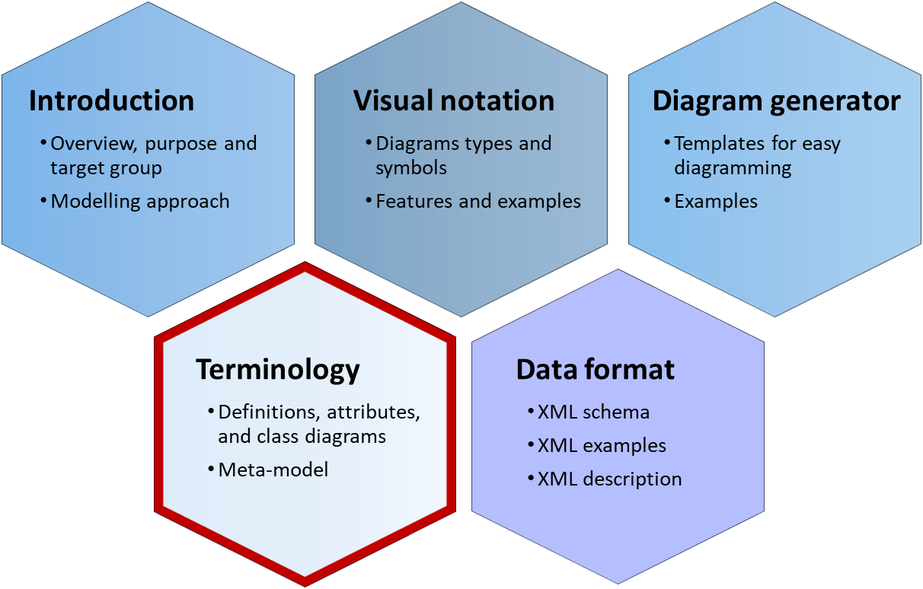
CJML abstract syntax
The Terminology document provides definitions and detailed class diagrams
The abstract syntax of CJML is described through a metamodel (UML class diagrams)
The main terms are journey, actor and touchpoints
Planned and actual touchpoints have different attributes
  Planned touchpoints have relative timestamps, while actual touchpoints have absolute timestamps.
  Only actual touchpoints have user experience.
  Actual touchpoints may have compliance values (planned, ad-hoc, failing, missing)
Planned Touchpoint
touchpointID: String deltaTime: Float touchpointDuration: Float uncertainty: uncertaintyValues [0..4] comment: String
Actual Touchpoint
touchpointID: String timeStarted: Datetime timeCompleted: Datetime compliance: complianceValues uncertainty: uncertaintyValues [0..4] comment: String
End User Experience
Planned Action
Planned Communication Point
Actual Action
Actual Communication Point
Introducing CJML
Theoretical foundation and modelling approach
A quick tour of CJML
From scenario to journey

Slide 25

Touchpoint typology
CJML allows for inclusion of external touchpoints, although they are more challenging to include in an analysis.
Directly involved actors
The actors on the left side are directly involved in delivering the service to the customer. They are responsible for (parts of) the customer's journey.
External actors
The actors on the right side may influence the customer's journey, although they are not responsible for any part of the service delivery.
Communication point
External communication point
Direct communication
Steps involving a "sender" and a "receiver" in the context of the customer's journey.
A communication channel is always involved.
Communication with the service provider or the service system. Often part of the planned journey.
Communication with an external actor who is not involved in the service provisioning
Action
External action
No communication
Steps without communication are called actions. They may or may not involve interaction with the service system.
Non-communicated observations and cognition is included here.
Action involving the service system.
Lisa grabs a shopping cart at the mall
Action not involving the service system.
Lisa writes a shopping list at home
These touchpoints involve the service system and can be controlled (to some extent) by the service provider.
These touchpoints occur outside the service system, and cannot be controlled by the service provider.
Introducing CJML
Theoretical foundation and modelling approach
A quick tour of CJML
From scenario to journey

Slide 26
Extra: Abstraction and granularity
CJML allows abstraction through journey phases, Example: before the travel, during the travel, after the travel. More information can be found in the terminology and visual notation.
Service processes often involve a number of activities and steps, and it can sometimes be challenging to divide the process into logical units.
The general rule is that the process should be divided into touchpoints carrying "the smallest unit of meaningful content" considering the purpose of the mapping.
Any change in these attributes signify delineation:
  The actor changes (for example air travel, when moving from check-in desk to security check a new person approach the traveller)
  The communication channel changes (or the device used by the end-user)
  The direction of the message flow changes
Modelling always involve some kind of simplification. To illustrate this, when making a pone call there is a number of steps that are not necessary to describe, e.g. "holding the phone to the ear".
Delineation of steps must always be seen in relation to relevance of the analysis. For most cases, dialling the telephone number is not important. However for an emergency service this step may be essential.
Example: Online shopping can be delineated as follows:
Browse products and add desired products
to the shopping cart
Choose delivery options and pay
Example: A visit to the doctor includes many actions.
Steps that are essential:
Making the appointment
The doctor's examination
The decision about further treatment
Steps that may be important:
Registration upon arrival (some might have systems that notifies the doctor about arrival)
Payment method
The time spent in the waiting room
Steps that are not important:
Transportation to the doctor’s office
Hang the jacket in the wardrobe at the doctor's waiting room
Introducing CJML
Theoretical foundation and modelling approach
A quick tour of CJML
From scenario to journey

Slide 27
Extra: Communication point or action?
Distinguishing communication points and actions can sometimes be difficult if one doesn't have definitions and guidelines to relate to.
Communication, as defined in CJML, requires that an actor sends a message directed to another actor. In addition, the message must be sent in context of the journey. As a consequence, a radio broadcast or advertisement on the bus is not considered a communication point but an action.
Note that acquisition of information (perception and cognition) is not defined as communication in CJML unless the information is actively communicated to an intended receiver and in the context of a journey.
Example 1: John reads and then signs a printed contract using a pen.
  This step is an action, as it does not involved communication
Example 2: John sends the contract to the insurance company.
  This step is definitely a communication point, as the message is actively sent to an intended receiver.
Example of touchpoints that involve direct communication:
A patient has a telephone conversation with the doctor.
The doctor receives an epicrisis from the specialist.
A patient receives a SMS reminder about the upcoming appointment with the doctor.
Example of touchpoints that are not defined as direct communication:
Writing down questions before a visit to the doctor.
Reading an information brochure at the doctor's waiting room.
Looking at the map of the hospital area to find the right building.
Introducing CJML
Theoretical foundation and modelling approach
A quick tour of CJML
From scenario to journey

Slide 28
A quick tour of CJML
Only a small selection of CJML’s visual features is shown here. The full specification can be found in the Visual notation document.
Diagram types and examples
Comparison of diagram types
User experience

Slide 29
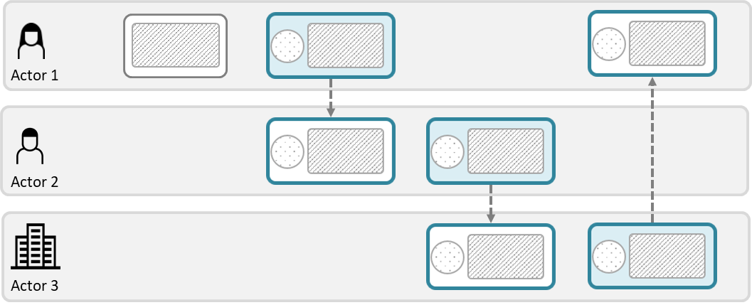


Overview - diagram types
Journey diagram
Suitable when focusing on the end-user
Suitable when few actors are involved
Suitable when emphasizing deviations from the planned journey
Journey network diagram (“swimlane diagram”)
Suitable when several actors are involved
Reveals both the sender and the receiver of a communication point
Shows the direction of the message flow
Note the difference in how the communication point appears in the two diagram types.
Introducing CJML
Theoretical foundation and modelling approach
A quick tour of CJML
From scenario to journey

Slide 30
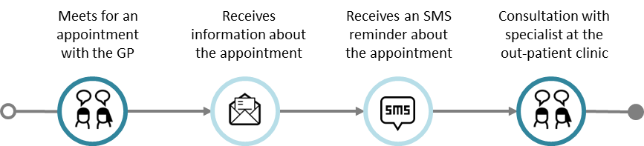
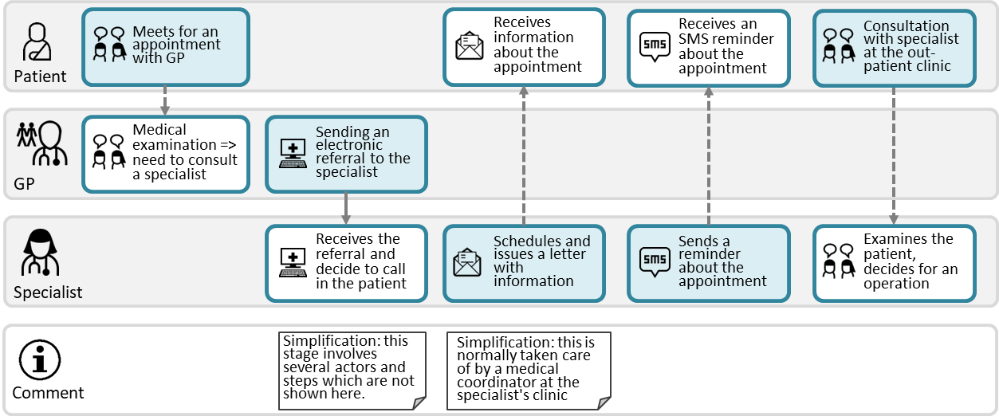
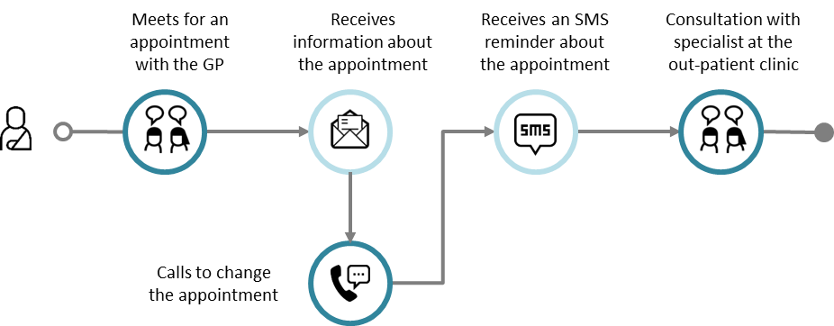
Example: Referral to a specialist
Journey diagram
Example of planned journey
Example of actual journey with a deviation
Journey network diagram
The patient journey in the upper swimlane corresponds to the planned patient journey to the left
The swimlane diagrams shows all the individual journeys at once, and it also reveals the exchange between the GP and the Specialist, which is not part of the patient journey
Planned journey
Actual journey
This is an example of a deviation from the planned journey
Introducing CJML
Theoretical foundation and modelling approach
A quick tour of CJML
From scenario to journey

Slide 31











Comparison of diagram types
Note the correspondence with the upper swimlane
Meets for an appointment with the GP
Receives information about the appointment
Receives an SMS reminder about
the appointment
Consultation with specialist at the
out-patient clinic
Journey diagram
(patient journey)
Journey network diagram
(“swimlane” diagram)
Meets for an appointment with GP
Receives information about the appointment
Receives an SMS reminder about the appointment
Consultation with specialist at the out-patient clinic
Patient
Medical examination => need to consult a specialist
Sending an electronic referral to the specialist
GP
Note that this touchpoint is invisible for the patient (and thus not part of the patient's journey above)
Receives the referral and decide to call in the patient
Schedules and issues a letter with information
Sends a reminder about the appointment
Examines the patient, decides for an operation
Specialist
Simplification: this stage involves several actors and steps which are not shown here.
Simplification: this is normally taken care of by a medical coordinator at the specialist's clinic
Comment
Introducing CJML
Theoretical foundation and modelling approach
A quick tour of CJML
From scenario to journey

Slide 32
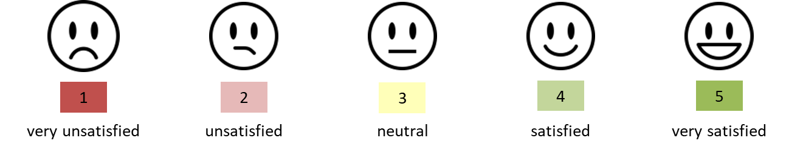
Customer/User experience
Introducing CJML
Theoretical foundation and modelling approach
A quick tour of CJML
From scenario to journey

Slide 33
Customer/User experience
CJML insists that a user's experience is individual and thus cannot be assigned to a journey on a general level. In this way, CJML differs from the majority of other customer journey approaches.
When representing user experience (UX), CJML adheres to principles from HCI research;
  UX is subjective
  UX is dynamic
  UX is context dependent
UX is thus associated with actual journeys only.
UX is based on a user's self-reported input.
  Otherwise it must be flagged as "anticipated user experience"
UX can be expressed in various ways, depending on the diagram type.
  Swimlane diagram: in a separate swimlane
  Journey diagram: as call-outs from a communication point
See for example Law, E. et al. (2009). Understanding, scoping and defining user experience: a survey approach. Proceedings of 27th SIGCHI conference on Human factors in computing systems (pp. 719-728).
Introducing CJML
Theoretical foundation and modelling approach
A quick tour of CJML
From scenario to journey

Slide 34
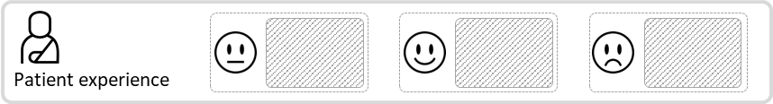
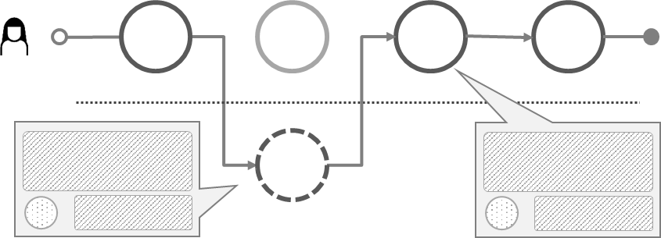
Customer/User experience
Emoticon based on rating
Text based on user's self-reported input
Journey network diagram
Journey diagram
Text based on user's self-reported input
Emoticon based on rating
Introducing CJML
Theoretical foundation and modelling approach
A quick tour of CJML
From scenario to journey

Slide 35
From scenario to journey
Example - alarm service
From business scenario to planned journey
From user scenario to actual journey

Slide 36
Describe the scenario
Start by describing a scenario (textual) and how it develops over time
  Which actors are involved?
  How do they communicate?
  What important steps are involved?
Identify the communication points among the actors and their essential attributes
  Who is the initiator/sender of a message?
  Who is the receiver?
  Which communication channel is used?
  When do the communication take place?
Identify important actions (non-communicating events).
  Which actions are essential for the scenario?
  Who are responsible for these actions
Describe chronologically what happens over time.
Introducing CJML
Theoretical foundation and modelling approach
A quick tour of CJML
From scenario to journey

Slide 37
Example – alarm service
This example illustrates the business case of a fictitious company, and how this can be transformed into a planned and actual customer journey.
The security company Safe@home offers installation and maintenance of alarm systems targeting the private market.
  The company has invested in a new online shop for self-service.
  A marketing campaign will be launched to attract new customers
Striving for a smooth and consistent customer experience, Safe@home has decided to map the planned journey for on-boarding of new customers
Scenario: see next slide
  Scope of the journey: from the time a customer places an order through the online shop, throughout installation and until payment of the first invoice.
Introducing CJML
Theoretical foundation and modelling approach
A quick tour of CJML
From scenario to journey

Slide 38
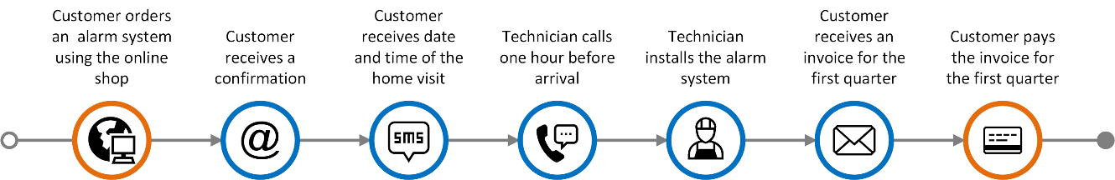
Detailed business scenario
This business scenario is now translated into a planned journey.
The scope of the customer journey is set from a customer places an order through the online shop, throughout installation and until payment of the first invoice.
Immediately after placing the order in the online shop the customer receives an e-mail that confirms the purchase and provides additional information about the process ahead.
A technician from Safe@home will carry out the necessary installation in the customer's home. After about two days the customer will receive an SMS with the date for the technician's home visit.
On the day of installation, the technician will call the customer about 1 hour upon arrival, to ensure that the customer is at home. The installation procedure will normally take less than an hour.
A few days after installation, the customer will receive a letter (old-fashioned mail) from Safe@home with additional information about the alarm system and an invoice for the first quarter of the subscription. It is assumed that the customer pays the invoice within the deadline.
Introducing CJML
Theoretical foundation and modelling approach
A quick tour of CJML
From scenario to journey

Slide 39
User scenario: Tina's journey
Tina is one of the many new customers going through the on-boarding process.
Tina needs a burglar alarm in her home and decides to go for a service offered by Safe@Home Inc. Using her laptop she orders an alarm service from the company's online shop. Everything seems to work fine, and Tina is very satisfied with the online shopping experience. A few minutes later she receives an e-mail confirming the details of the order. She is also informed that a technician will take care of the installation of hardware in her home, and that she will receive an appointment date for the home visit.
A few days later Tina receives an SMS from Safe@Home with the time and date for installation. She finds that the suggested date does not suit her plans, as she will be on a business travel at the time for the home visit. Tina calls the support centre but of reasons unknown the connection is broken. She has to leave for an appointment with a friend, and decides to call back later.
The following day she is able to reach the call centre. A new date is settles for the home visit, and immediately after the telephone conversation she receives a confirming SMS. The following week, on the day of the installation, the technician calls her from his car, telling her he is on his way. The technician installs the alarm system without any problems. After a couple of days, Tina receives a letter containing tips and information. It also includes an invoice concerning the first period. The bill contains elements and accounts that Tina is not able to recognize from the marketing campaign. She therefore sends an e-mail to get an explanation. Tina gets an answer per e-mail during the same evening explaining the details of the invoice. Being a considerate customer, Tina pays the invoice through her internet bank the same evening.
Introducing CJML
Theoretical foundation and modelling approach
A quick tour of CJML
From scenario to journey

Slide 40
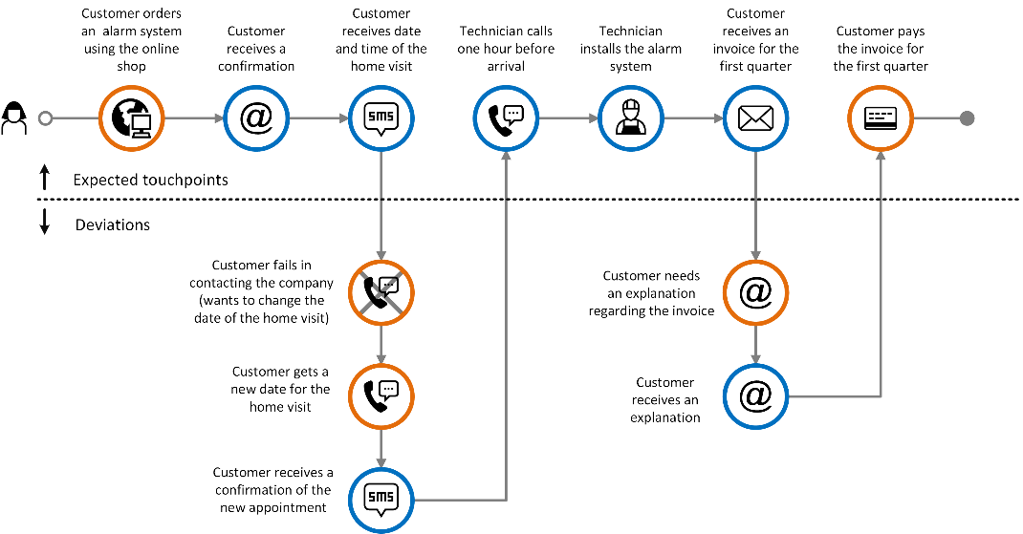
A model of Tina's actual journey
Note how the deviations from the expected journey are represented.
Introducing CJML
Theoretical foundation and modelling approach
A quick tour of CJML
From scenario to journey

